Slide 1



Team engagement for The Digital Era:
Avaya Conferencing
Roger Wallman
Sr. Manager Product Marketing – Enterprise Solutions
rwallman@avaya.com

Slide 2

OUR VISION is to help people and organizations to move to the digital AGE of communications
Avaya Everywhere
A smart, digital world where all communications across devices and software apps are secure, in-context.
Notes:
Our vision is to help people and organizations to move to this digital world.
We see Avaya everywhere. Embedded in browsers, apps, software platforms providing the essential communications services. We have a vision of providing the communications across devices and apps securely and in context.
To achieve this our technology strategy includes these things:
Our technology has these attributes -- embedded, multi-platform, mobile, designed to increase speed & risk mitigation, ready to automate any customer service workflow
We take manual communications processes and automate them to improve experiences for our customers customers
We are building the industry’s most powerful, simplified, software-defined architecture and infrastructure for communications

Slide 3



Digital transformation
Driving the Need for UC Evolution
DIGITAL TRANSFORMATION ERA
MOBILE ERA
Avaya is defining the future
of UC making it a natural part
of how we connect,
communicate and collaborate.
UC on the devices, within the applications and browsers people use every day:
simple, transparent, in context, user defined.
UNIFIED COMMUNICATIONS ERA
Notes:
Global transformation to digital is at the heart of the change we are seeing in communications and the foundation of how organizations stay relevant in the future. This digital transformation is driving the need for an evolution in unified communications. Customers, employees and partners, they are demanding a user driven communications experience; defined by users and line of business leaders that fits into how they work instead of changing how they work. The rigid experience historically driven by IT – is becoming a thing of the past.
Now if you look at the unified communications continuum, you can see how it’s evolving in our favor.
Unified Communications Era
Historically, unified communications was largely about IT cost savings and desktop consolidation where you needed to have all these capabilities in one desktop app, the desktop team had control over the user experience, and it was under the umbrella of employee productivity.
Mobile Era
With the mobile era, this started where everyone is coming to work with at least one mobile device. Organizations leverage the power of these employee owned devices. And employees expect that they can access their enterprise services anywhere with the same intuitiveness and simplicity of their consumer apps, which is very different compared to a traditional enterprise, IT defined desktop environment.
Digital Transformation Era
This next era, the digital transformation era, and all of our customers should have a digital transformation strategy that we are a part of. In every vertical business, there are initiatives to make sure they are relevant in this era, and provide innovation in their space because there is so much disruption happening with traditional verticals exploiting new digital technologies. Just look at Uber or Airbnb as examples.
This era is line of business focused and about driving contextual experiences and outcome, hard dollar ROI and KPIs. With the diverse nature of our customer base, for them to drive the necessary business results in this digital era, it requires openness with technology that we have like Avaya Breeze and our ECO-system.
The capabilities from the unified communications era and the mobile era – they’re still required in the digital transformation era, and we have a superior solution at whatever stage your customer is in. And our solution is ready now for your customer’s transformation. We are defining the future of UC – making it natural and a part of how we communicate every day on our device of choice, within a browser or embedded in the applications we live in. Simple, transparent, in context and user defined.

Slide 4









Avaya for SMART Communications
CUSTOMER ENGAGEMENT
(Multi-touch Customer Experience)
TEAM ENGAGEMENT
(Rich Collaboration Tools)
USE CASE DRIVEN
(People, Process / Dynamic, Things)
ECO-SYSTEM
(Take your business further)
AVAYA BREEZE APPLICATIONS PLATFORM & CLIENT SDK
ANYWHERE, ANYTIME COMMUNICATIONS
Avaya is uniquely positioned to transform your customer experience,
enhance the productivity of your employees and to transform your business processes
Notes:
This slide shows how Avaya is extending its Customer and Team Engagement capabilities, provided by our traditional anywhere, anytime communications platforms into the new realm of customer specific use cases and eco-systems through Avaya Breeze and the SDK.

Slide 5


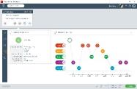

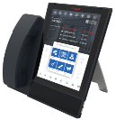

Delivering on the vision
Avaya Equinox™ Mobile, desktop, browser, conference room collaboration
Avaya Vantage™ Mobile App simplicity with the benefits of a contemporary dedicated device
Avaya Breeze™ Client SDK Accelerate outcome centric solutions that drive productivity and performance
Avaya Equinox
Avaya Vantage
Custom Experiences
Avaya Oceana Workspaces
Avaya Breeze Client SDK
Customer Engagement
Team Engagement
Conferencing
Notes:
At GITEX in Dubai in October, we positioned Avaya UC for the Digital Transformation Era through the market launch of Avaya Equinox, Avaya Vantage and the Avaya Breeze Client SDK.
Avaya Equinox is the name for our fully integrated software-based UC solution. Equinox includes the convergence of all of our soft clients, Avaya Aura Conferencing and Scopia. A single, all channel calling, messaging, conferencing and collaboration solution for mobiles, browsers, desktops and room systems.
Avaya Vantage was previously announced at IAUG with Oceana, but is also an important element of the launch. This distinctive, all glass endpoint is the fusion of mobile application simplicity with the benefits of a dedicated device.
The Avaya Breeze Client SDK is the ultimate UC customization tool to accelerate solutions that drive even more productivity and performance.
Now let me take a step back and speak to our Avaya Breeze Client SDK strategy in general.
The SDK is a basis on where the market is going. It’s much easier now to embed communications into your applications. The SDK is part of the Avaya Breeze portfolio that enables embedding advanced communications in user and business applications. Avaya Breeze and the Snap-in’s provide the heart of the customer’s new applications, and the SDK enables them to put a user interface on those applications and processes. Our own turn-key clients like Oceana Workspaces and Avaya Equinox are both built using the Breeze Client SDK. This common SDK breaks down the silos of what constitutes a customer contact feature vs a UC feature, and the developer can decide what an optimized experience looks like and select from any supported functionality.
The application possibilities for the SDK are almost unlimited. Avaya Professional Services, yourselves - our Partners and even customers can leverage the SDK to create a multitude of unique clients based on simple APIs delivered in a set of extensible packages. The SDK also allows client functions to be built into existing applications and web services interfaces, for example, into CRM apps like salesforce.com, or SAP.

Slide 6
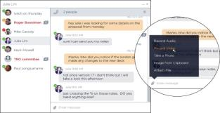
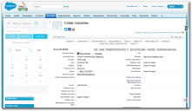


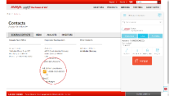
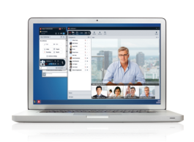
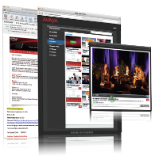

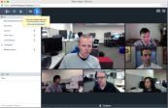

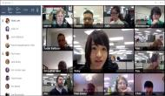
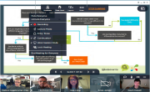
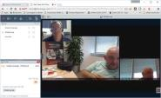

Avaya equinox
IN-APP UC EXPERIENCE
User-defined UC in the apps you use Embed, integrate, customize
MOBILE-FIRST UX
One touch to...Anything
Simple, easy, contextual, device optimized experience
ALWAYS ON MESSAGING
Any Media
Device Continuity
EXTENSIVE WEB COLLABORATION & CONFERENCE STREAMING
Screen & application sharing, whiteboard, remote desktop control
100,000 live viewers
RICH HD VIDEO,
HIGH SCALE AUDIO
Hollywood squares, multi-vendor room system interop.
Multiple large meetings
SOFTWARE BASED / ZERO DOWNLOAD
Flexible, virtualized deployment
Frictionless collaboration via WebRTC and HTML5
Notes:
Like I was saying a minute ago, Equinox is a single, all channel calling, messaging, conferencing and collaboration solution for mobiles, browsers, desktops and room systems.
With the new Equinox client for Windows, OSX, iOS and Android, Equinox delivers a mobile first experience with an action oriented workflow for immediate response. Workers can quickly see all scheduled meetings, messaging updates, and communications history in one place and take immediate action with a single touch. Optimized to the device – mobile, tablet, desktop, browser and Avaya Vantage – the experience maintains mobile simplicity while embracing the benefits inherent in a wide range of devices.
Persistent, multimedia messaging for text, audio, video, images and files allows employees to access and send team messages in real time – or anytime. A conversation initiated on the desktop in the morning can be picked back up on the mobile device at lunchtime, for example. Workers can even message those who are offline for more efficient team interaction.
You can embed Avaya Equinox communication and collaboration capabilities within business processes or context, or into any business application to create and integrate unique solutions for vertical needs and competitive differentiation.
Avaya Equinox provides a single platform that supports all the different modes of conferencing. High scale audio conferencing, extensive web collaboration, rich multi-vendor HD video, even event streaming to 100,000 users in an all-in-one software solution.
With Equinox you get reliable, secure, high-quality HD voice and video for communication anywhere on any device, with easy, remote access including VPN-less connectivity. One number reach for all devices accelerates enterprise workflows and deployments; workers even can simultaneously use multiple devices.
And you can skip the download and collaborate directly in a browser. Equinox enables robust collaboration from within HTML5 browsers with no downloads or plugins needed, thanks to WebRTC technology. This best-in-class browser experience with full collaboration capabilities eliminates migration challenges for organizations in the process of transitioning desktop business applications to the web and/or shifting applications to the cloud.

Slide 7

Avaya key benefits
1
Mobile First – Enterprise Class Communications
2
Best In-App Experience Advantage
3
SMART Digital Solution Accelerator
4
Powerful Collaboration for ALL
Collaborate in Context, from Anywhere, without Compromise
Notes:
Now lets change it up and talk about Equinox in terms of it advantages.
First up is “The Mobile First – Enterprise Class Advantage”
We spent a lot of time on the UI, which is where the mobile first design paradigm comes from. We threw everything up in the air and said how do we make people super productive on a mobile device with a restrictive form factor. We started with mobile making it highly intuitive and then we expanded that out to a tablet, then to the desktop, then to a browser and that’s how the design came about. When you have more real estate, when you have different environments, or additional platform capabilities like multiple monitors, then we take advantage of that, while maintaining mobile simplicity. We looked at making the installation process as easy as possible through auto discovery – pretty much what users expect when installing an app.
For the 2016 Unified Communications Magic Quadrant, Gartner placed additional emphasis on the importance of telephony within UC because of increased expectations in the enterprise. We’ve been strong in this area since day one. Equinox delivers enterprise class, reliable, high quality voice and video with all the security and telephony features you expect – even in a mobile environment. With Multiple Device Access (MDA), users can leverage their contacts, logs and messaging transparently across devices and they have easy capabilities to record content. And perhaps one of the best features for mobile users is that VPN isn’t required for remote access.
Next, we’ve got – “The Best In-App Experience Advantage”
We all know that end users within business units are accessing their business applications in a browser. With the work done by Google with Google Apps and the increase in focus by Microsoft Office on browser-based access to productivity tools, users are now able to work completely in the browser from anywhere with this cloud application delivery model. Many of our customers have started their journey towards this approach, and with Equinox we can embed communications within the application that is being used. UC is no longer another app that sits on the desktop, the communications functions are brought forward and made available to the user in context, when they need them and how they need them, without switching applications.
And on to our 3rd Advantage – “The Smart Digital Solution Accelerator Advantage”
With the Avaya Breeze Client SDK, it’s now much easier to create and customize the experience and embed communications into existing applications and web services interfaces. The application possibilities for the SDK are almost unlimited. Users can collaborate within the context of the business processes they deal with every day. And its more than an SDK, customers can leverage the Avaya Breeze Snapp Store and save time with workflow automation and other pre-built code modules from the eco-system to extend and integrate their solutions. One last thing on the SDK, we use it ourselves to create our own clients – like Equinox that we’ve been covering today, and Oceana Workspaces.
Now our 4th advantage – Powerful Collaboration for all – this is about the conferencing and collaboration capabilities that we're going to talk about in the rest of this presentation.

Slide 8
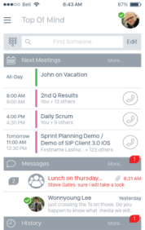




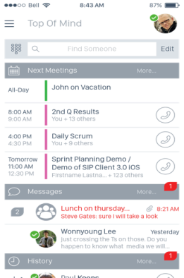
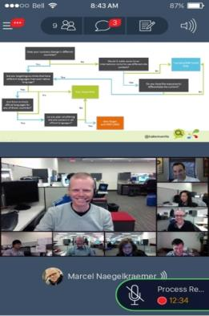
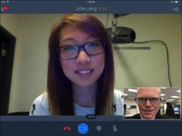
1. mobile first – Enterprise class
MOBILE FIRST USER EXPERIENCE
INNOVATIVE ‘TOP OF MIND’
Simple, easy, contextual controls
Device optimized experience
Auto discovery installation!
Action oriented workflow
One touch to…anything
One Touch for
Rapid Response
Notes:
First up is “The Mobile First – Enterprise Class Advantage”
Mobile First User Experience
We spent a lot of time on the UI design, which is where the mobile first design paradigm comes from. We threw everything up in the air said how do we make people super productive on a mobile device with a restrictive form factor. We started with mobile first making it highly intuitive and then we expanded that out to a tablet, then to the desktop, then to a browser and that’s how the design came about. When you have more real estate, when you have different environments, or additional platform capabilities like multiple monitors, then we take advantage of that, while maintaining mobile simplicity. We looked at making the installation process as easy as possible through auto discovery – pretty much what users expect when installing an app.
With mobiles, people are checking them every 5 to 15 minutes for a variety of reasons. In our mobile first design approach, a key goal was to provide an action oriented workflow with one click or touch to anything you needed to do.
Innovative ‘Top of Mind’
And this is one of our areas of differentiation. As you would expect, it’s easy to claim, but difficult to prove that your user interface is differentiated, but we have specific things like our new Top of Mind screen that enables users to stay on top of their interactions. When they look at their mobile device they can quickly see what meetings they’re late for, need to join or are coming up, what missed calls they have, left voice mails or updates to group chats and instant messages. It’s not just about intuitive notifications, the power is in the action oriented design. Users can easily respond to each of those interactions directly from the Top Of Mind screen. In the case here, you get a real-time view of your meetings, and with one touch can immediately join into a meeting with video and content.

Slide 9
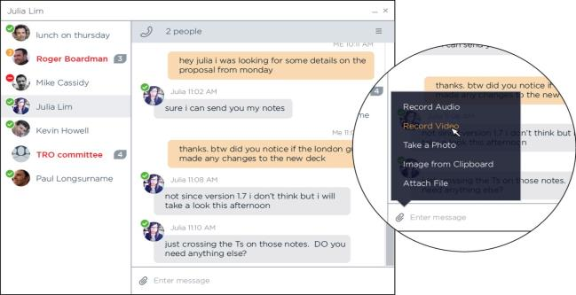
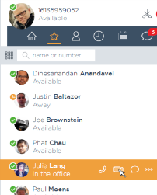
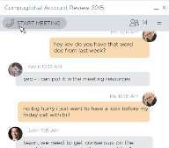
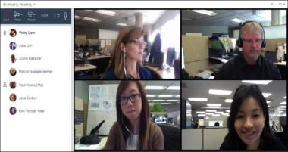
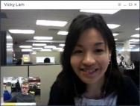
1. mobile first – Enterprise Class
ALWAYS-ON MESSAGING
ENTERPRISE CLASS HD
VOICE & VIDEO
Reliable, secure, HD voice & video
Multi Device Access (MDA)
Simple recording and playback
No VPN required
Any media
Device continuity
Notes:
Always-On Messaging
With our new always-on messaging, users can send and access team messages in real time, or at their time with persistent multimedia messaging for any media - text, audio, video, images and files. They can start the conversation on their desktop and pick it back up on their mobile with device continuity. You can even message someone offline, and escalate a messaging session to a call or conference – again, with just one touch or click.
Now the best way I think to close on “The Mobile First – Enterprise Class Advantage” is that the user experience on mobiles and desktops is simply awesome.
Enterprise Class HD Voice and Video
For the 2016 Unified Communications Magic Quadrant, Gartner placed additional emphasis on the importance of telephony within UC because of increased expectations in the enterprise. We’ve been very strong in this area since day one. Equinox delivers enterprise class, reliable, high quality voice and video with all the security and telephony features you expect – even in a mobile environment without compromises. With Multiple Device Access (MDA), users can leverage their contacts, logs and messaging transparently across multiple devices and they have easy capabilities to record important content. And perhaps one of the best features for mobile users is that VPN isn’t required for remote access.

Slide 10

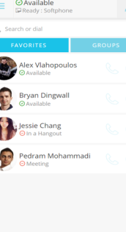
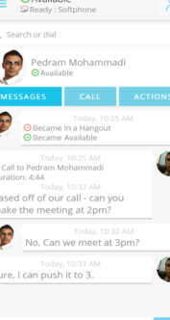
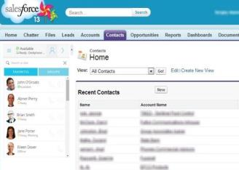
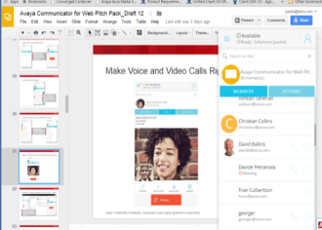
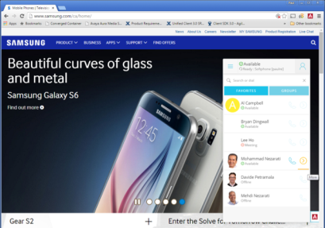
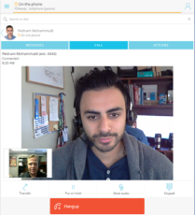



2. Best In-app experience
With Avaya Equinox for Web
NO SOFTWARE SOLUTION
VOICE / VIDEO
IN-APP UC WORKFLOW
Contacts, IM and Presence
Collaboration Actions
Unified Messaging
Integrated Conferencing
Contextual Collaboration
Screen-pops
CTI
Click-to-X
Web RTC or Phone

Slide 11
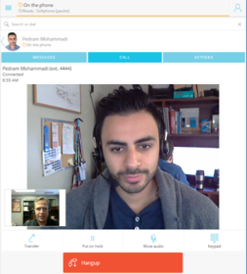

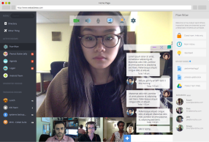
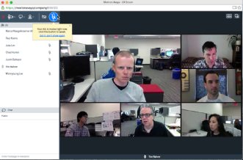
Complete Browser Solution
Extends to “IN-APP” Cloud Work-flow
EQUINOX FOR WEB
MEETING INTEGRATION
BEST OF CLOUD
+
+
In-App UC Experience
Contacts, IM and Presence
Office 365 or Google Apps
Collaboration Actions
Unified Messaging
Avaya Equinox Meetings
Zang Spaces
Others…
Salesforce.com
Others…

Slide 12
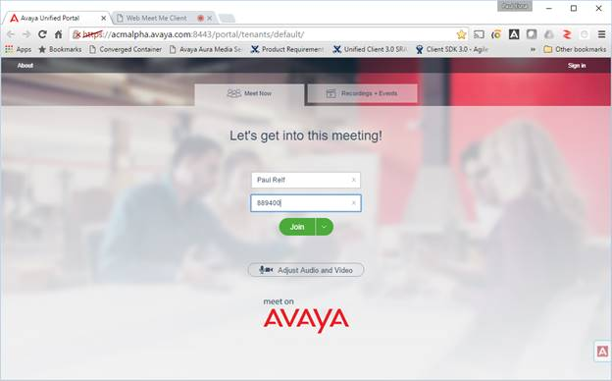
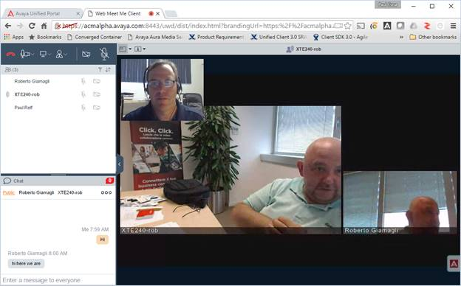
Friction-less Meeting experience
Notes:
It is worth noting, we have been very focused on the user experience across all elements of the portfolio and Project Eclipse is no different. Avaya is embracing Web RTC standards across all solution elements. This allows for ‘no software’ or perhaps better termed ‘no plugin’ solutions. Installing plugins or helper applications, has to be the biggest pain point from an end user point of view. By embracing Web RTC we are able to provide highly compelling user experiences by taking advantage of the media capabilities emerging in Browsers. In this screen shot you see an updated and very inviting landing page, and on the screen on the lower right you can see it is possible to have very rich user experiences when connected over Web RTC.

Slide 13


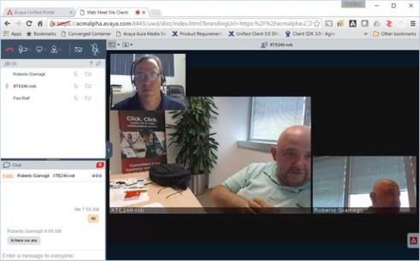
Ad-Hoc, Scheduled and Persistent Meetings
Full Range of Collaboration Use Cases
A new way to organize people, teams and assets to get work done by engaging in always-on workspaces anchored on activity streams
Collaborate through video and group chat. Contextual links to other team resources like shared documents and storage
Teams can be formed with anyone, across organizational boundaries
Fully featured virtual room for group video, audio conferencing and web collaboration
HD Video with Room Integration
Highly scalable supporting audio, video and web conferencing needs

Slide 14





Future Proof – Software Based
Addressing All Markets Trends
Moving to SW & Virtual Switching + Transcoding | Infrastructure on the Cloud | Multiple Device Accessability | Simplicity | WebRTC

Slide 15




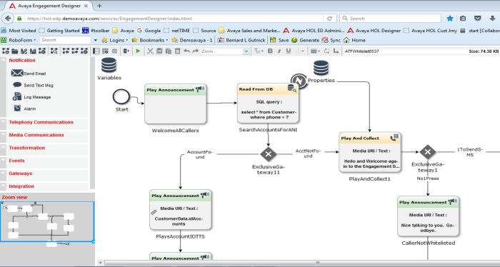
3. smart digital solution accelerator
AVAYA BREEZE CLIENT SDK
Simplifies creating and customizing the user experience
Enables communication and collaboration within context and business processes
Embed into any application
Build unique vertical applications
Extend and integrate quickly through Avaya Breeze, workflow automation, and Snapp Store eco-system
We use it ourselves!
Notes:
And on to our 4th Advantage – “The Smart Digital Solution Accelerator Advantage”
With the Avaya Breeze Client SDK, it’s now much easier to create and customize the experience and embed communications into applications. The application possibilities for the SDK are almost unlimited. Avaya Professional Services, DevConnect Partners and even customers can leverage the SDK to create unique vertical applications, embed functions into existing applications and web services interfaces. Users can collaborate within the context of the business processes they deal with every day.
And its more than an SDK, customers can leverage the Avaya Breeze Snapp Store and save time with workflow automation and other pre-built code modules from the eco-system to extend and integrate their solutions.
One last thing – we use it ourselves to create our own clients – like Equinox that we’ve been covering today, and Oceana Workspaces.

Slide 16


Introducing the New Client SDK
Avaya’s Ground Breaking Developer Tools That Makes It Easy To…
DEVELOP AND DEPLOY
new collaboration applications quickly
(Avaya Breeze Snap-Ins)
automating and improving
Business Work-flow
EMBED COMMUNICATIONS
in your applications
(Avaya Breeze Client SDK)
making Users more Effective
and Engaged
NEW

Slide 17





Sample SMART Digital Enablement
With Avaya Breeze and Client SDK
DIFFERENTIATED EXPERIENCES FOR YOUR CUSTOMERS
Hospitality
Revolutionize the bed side ‘phone’ experience
Kiosks / Auto Attendant
Show case your brand with a modern and fresh walk up experience
NEW AND COMPELLING APPLICATIONS
Customer Care
Combine front and back office work-flow for improved service delivery
Health Care
Integrate communications directly into the work-flow for improved care delivery
COMMUNICATIONS ENABLE ANYTHING
Avaya Partner
Develop packaged and custom applications for your customers
Internet of Things
Mobile and Web RTC connecting users and devices in ways that were just never possible before

Slide 18
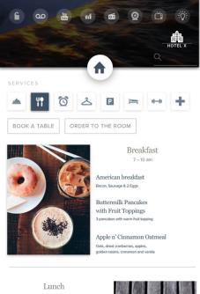
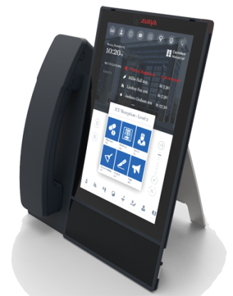
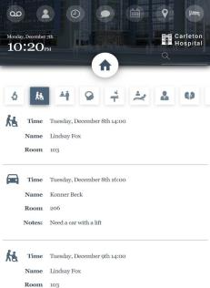
EQUINOX Runs on avaya vantage™
AVAYA VANTAGE
ANDROID + APPS + SDK =
ENDLESS POSSIBILITIES
                Always-On, Always Ready
                Fusion of mobile app simplicity with contemporary dedicated device
                Secure, administrable
                Excellent acoustics
                Equinox out-of-the-box
Customizable via Breeze Client SDK
                Deliver unique business application
                integration, Ideal for verticals
                Value above and beyond IP deskphone
Notes:
That brings us to Avaya Vantage. Vantage is always-on, always ready and always available. It’s a unique fusion of mobile application simplicity in a contemporary dedicated device. Now as a deskphone, it’s gotta be the coolest phone on the planet with a 7 inch glass display and no visible physical keypad or buttons. And it comes with all the superior telephony capabilities customers expect from Avaya – its secure, you can administer it and it has excellent acoustics, along with the Equinox mobile first experience out of the box. But we’re not marketing this as a pretty phone. Vantage is an application platform supporting our Breeze Client SDK.
You can start with an out-of-the-box Equinox experience and then customize it for your vertical application, or wipe the slate clean and easily create unique business application integration from the ground up with the Breeze Client SDK. Vantage is ideal for verticals like hospitality, healthcare, retail, or entertainment where a customized solution can provide value far beyond an IP desk phone with a tightly controlled user interface and feature set.

Slide 19

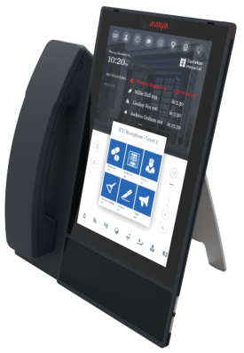



SAMPLE Customization for Verticals
HEALTHCARE
RETAIL
As a dedicated desktop device Avaya VantageTM enables unique custom experiences - meshing into customers’ workflows and business processes.
Customize apps for verticals such as hospitality, healthcare, retail, government, media & entertainment.
HOSPITALITY
MEDIA &
ENTERTAINMENT

Slide 20
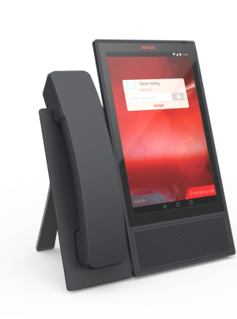
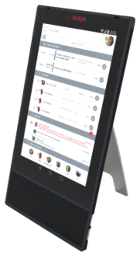
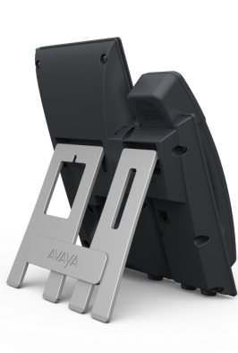
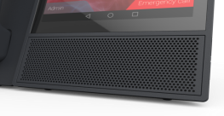
Avaya Vantage™
Avaya VantageTM pushes the boundaries of user experience
Simple & ready for instantaneous human engagement
  Customizable touch screen
  Secure, dedicated device – advantages of a phone AND flexibility of an application platform
  Always on, Always Available, Always Powered.
Contemporary form factor
  All-glass device
  No visible mechanical buttons
  Camera (optional)
  Optional cradle w/handset
  Acoustic excellence
  Simple to deploy - desk mount plus a wall mount
Why a dedicated device: Simple! Always On, Always Powered, Always Ready!

Slide 21







Some of our Early Adopters
SMART Healthcare
SMART Hospitality
Internet of Things
Notes:
SMART Healthcare
Humber River Hospital – A true smart hospital with 36,000++ connected devices for 656 beds, all integrated.
Avaya Equinox trial customer with full mobile deployment planned including secure messaging and upgrade of Scopia to Equinox solution.
Avaya Breeze application to enable value-added ‘nurse call’ application on bed-side infotainment device.
SMART Hospitality
Digivalet and iRiS – market leading software vendors that deliver transformative guest experiences for hotel properties
Both are Client SDK early adopters building integrated guest communication capabilities within their portfolio offerings.
Internet of Things
Arrow Electronics – In addition to being a Platinum Avaya partner, Arrow SI’s parent company is a leading player in the electronics space -- with a keen eye on IoT. Avaya Breeze integration into Arrow’s IoT platform facilitates solution enablement across a wide range of important verticals, including Life Sciences & Healthcare, Retail, SMART cities and Manufacturing.

Slide 22
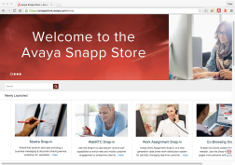
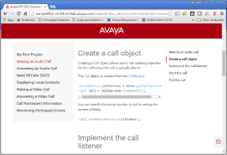
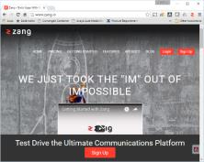
smart digital solution accelerator
Eco-system Enablement
Snapp Store
DevConnect
Zang.io
Download, Deploy and Run Fully Functional applications on your
Avaya Breeze platform
3rd Party ISV’s and Developers
rolling out Snap-Ins to help you
execute your business goals
Simplify Application Development
with Pre-Built Modules
No other vendor allows you to extend your core platform like Avaya
Avaya’s developer partner program
Full access to developer resources (docs, guides, SDKs, and APIs)
Avaya Collaboratory — Avaya's
cloud-based, developer sandbox. Design, create and deploy apps for mobile, web, telephony, email, SMS
and video engagement, all without the need for any on-premises components
Rich Cloud API offering Communication Platform as a Service
Extend your work-flow through Cloud connectivity
Scale up and down with Usage based metering

Slide 23
Avaya key benefits
1
Mobile First – Enterprise Class Communications
2
Best In-App Experience Advantage
3
SMART Digital Solution Accelerator
4
Powerful Collaboration for ALL
Collaborate in Context, from Anywhere, without Compromise
Notes:
Now lets change it up and talk about Equinox in terms of it advantages.
First up is “The Mobile First – Enterprise Class Advantage”
We spent a lot of time on the UI, which is where the mobile first design paradigm comes from. We threw everything up in the air and said how do we make people super productive on a mobile device with a restrictive form factor. We started with mobile making it highly intuitive and then we expanded that out to a tablet, then to the desktop, then to a browser and that’s how the design came about. When you have more real estate, when you have different environments, or additional platform capabilities like multiple monitors, then we take advantage of that, while maintaining mobile simplicity. We looked at making the installation process as easy as possible through auto discovery – pretty much what users expect when installing an app.
For the 2016 Unified Communications Magic Quadrant, Gartner placed additional emphasis on the importance of telephony within UC because of increased expectations in the enterprise. We’ve been strong in this area since day one. Equinox delivers enterprise class, reliable, high quality voice and video with all the security and telephony features you expect – even in a mobile environment. With Multiple Device Access (MDA), users can leverage their contacts, logs and messaging transparently across devices and they have easy capabilities to record content. And perhaps one of the best features for mobile users is that VPN isn’t required for remote access.
Next, we’ve got – “The Best In-App Experience Advantage”
We all know that end users within business units are accessing their business applications in a browser. With the work done by Google with Google Apps and the increase in focus by Microsoft Office on browser-based access to productivity tools, users are now able to work completely in the browser from anywhere with this cloud application delivery model. Many of our customers have started their journey towards this approach, and with Equinox we can embed communications within the application that is being used. UC is no longer another app that sits on the desktop, the communications functions are brought forward and made available to the user in context, when they need them and how they need them, without switching applications.
And on to our 3rd Advantage – “The Smart Digital Solution Accelerator Advantage”
With the Avaya Breeze Client SDK, it’s now much easier to create and customize the experience and embed communications into existing applications and web services interfaces. The application possibilities for the SDK are almost unlimited. Users can collaborate within the context of the business processes they deal with every day. And its more than an SDK, customers can leverage the Avaya Breeze Snapp Store and save time with workflow automation and other pre-built code modules from the eco-system to extend and integrate their solutions. One last thing on the SDK, we use it ourselves to create our own clients – like Equinox that we’ve been covering today, and Oceana Workspaces.
Now our 4th advantage – Powerful Collaboration for all – this is about the conferencing and collaboration capabilities that we're going to talk about in the rest of this presentation.

Slide 24
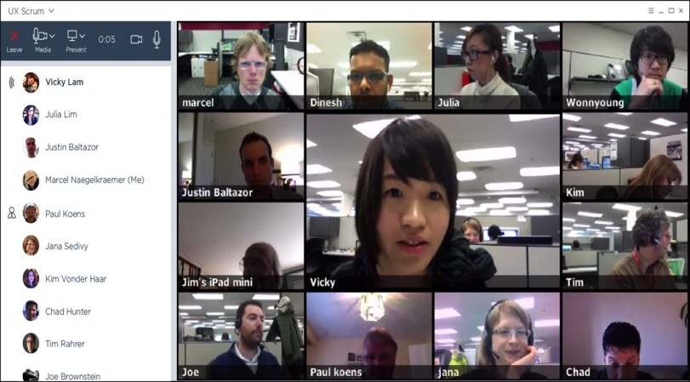

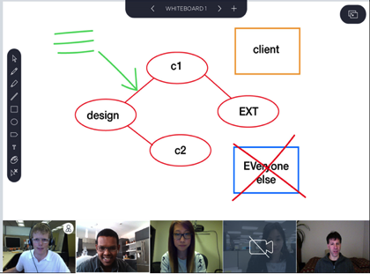
4. Powerful collaboration for all
HIGH SCALE AUDIO
Multiple large, simultaneous
meetings
CLIENT SUITE / WEBRTC
UC, zero download
with browsers, client apps
EXTENSIVE WEB COLLABORATION
Screen & application sharing, whiteboard, remote desktop,
keyboard & mouse control
INTEGRATED EVENT CONFERENCING
HD video & content streaming to 100,000 live viewers
SOFTWARE BASED
Flexible, virtualized deployment
RICH HD VIDEO
Hollywood squares, multi-vendor room system interop.
Notes:
“The Powerful Collaboration for All Benefit”
Many customers have different solutions for all the different types of conferencing that they’re doing because of the specific requirements for those applications. They might have an audio conferencing service that they use to support large meetings, they typically have a web conferencing application that they use for webinars with screen and application sharing, they might have a separate deployment of video conferencing room systems, and yet another system or service for streaming large scale events. These all might be called unified communications, but it’s not particularly unified in any way – and all these separate solutions don’t necessarily work well together.
Avaya Equinox combines the best of Scopia and Avaya Aura Conferencing into an uber conferencing solution, an all-in-one platform supporting all the different modes of conferencing. High scale audio conferencing, robust web collaboration with an extensive feature set, rich HD video that’s multi-vendor room system interoperable, even event streaming to 100,000 users in an all-in-one software solution.
Users have one login and one easy solution to learn. IT has one solution to administer with one set of statistics for ROI analysis, single provisioning, a smaller footprint – all with higher efficiency and lower costs, and all the modes of conferencing work seamlessly together.

Slide 25
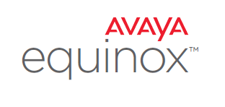
Team Engagement Convergence
HISTORY
AVAYA EQUINOX FULL CONVERGENCE
R2.1
Avaya Communicator
Flare
R
1.1
Uses Common Avaya Breeze Client SDK
One-X Mobile
R
6.2
SINGLE, FULLY FEATURED USER EXPERIENCE
Multi Platform
Enterprise Telephony
Presence, Multimedia Messaging, Lync Federation
Audio / Video / Web Conferencing
Client SDK based
One-X Communicator
R
6.2
Scopia
R
8.3
CONVERGED CONFERENCING
Virtualization
Audio / Video / Web Conferencing
Portal with WebRTC
Recording / Streaming
Integrated with Team Engagement Clients
Avaya Aura Conferencing
R
8.0
FP3
R
8.3
Interop 2014
Integrated
Collaboration 2015
R
8.3
Scopia
R
8.3
FP2
Notes:
Many of you that have been following our releases know that we've been on the paths of convergence for both our clients and conferencing for some time. We combined Flare and One-X Mobile into Avaya Communicator 2.1, and now with Equinox, we are combining the capabilities of One-X Communicator, Scopia, and Avaya Communicator into the new Equinox client.
The convergence of Scopia and Avaya Aura Conferencing infrastructure started in 2014 with interoperability between the two platforms; and then continued in 2015 where the web collaboration capabilities of AAC were integrated into Scopia with version 8.3, Feature Pack 2.
Avaya Equinox completes the infrastructure convergence combining the best of Scopia and Avaya Aura Conferencing into an uber conferencing solution. An all-in-one platform supporting all the different modes of conferencing. High scale audio conferencing, robust web collaboration with an extensive feature set, rich HD video that’s multi-vendor room system interoperable, even event streaming to 100,000 users in an all-in-one software solution.

Slide 26








Powerful Collaboration for all
Avaya Convergence
Equinox Servers
AAC 8 (GA Now)
Scopia 8.3 (GA Now)
Scalable Audio
Scalable Audio
Web Collaboration
Rich Video
Room Integration
Full Client Suite
Software Based
Transcoded Video
Web Collaboration
Room Integration
Switched Video
Remote Access
Software Based
Hardware Based
Notes:
How Equinox Conferencing gets built is that scalable audio conferencing, rich web collaboration, and voice-switched video come from Avaya Aura Conferencing. Sophisticated video processing and transcoding, standards-based video room system integration, along with the broad range of remote access capabilities for desktops and mobile devices come from Scopia. Equinox delivers the best of both worlds, and even better it's software-based and virtualizable.

Slide 27
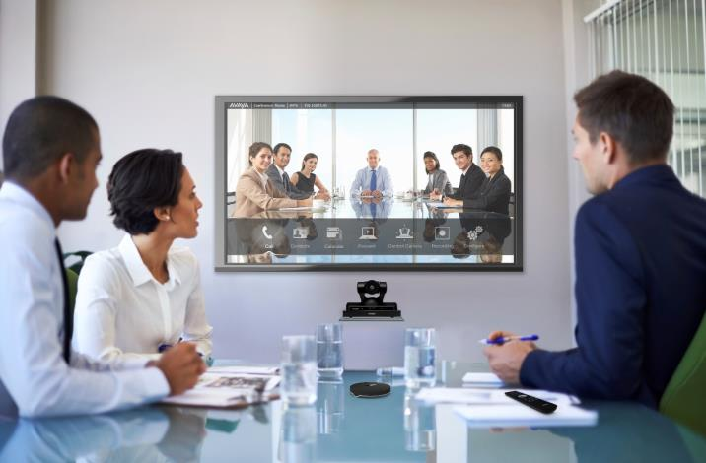

Rich hd video conferencing
Multi-Vendor Integration
Full interoperability with virtually any video room system
Transcoded video up to 28 Hollywood squares
SIP clients like H175 Video Collaboration Station supported
3rd party video room system management
  Cisco, Lifesize, Polycom, Tandberg
Microsoft Lync 2013 & Skype for Business support
Mary Meeker, Morgan Stanley, Mar 2012
Notes:
Equinox delivers rich HD video conferencing capabilities including full interoperability with virtually any video room system, transcoded video with up to 28 Hollywood Squares, and support for SIP clients like the H175 Video Collaboration Station.
The management system manages not just our own Scopia room systems, but also Cisco, Lifesize, Polycom and older Tandberg systems. Management includes capabilities like setting up directories and address books, system monitoring, remote upgrades, resets, and configuration.
Microsoft Lync 2013 & Skype for Business are supported as they are today through the Scopia gateway for Microsoft.

Slide 28
Powerful Collaboration for all
Scalability
 | Transcoded Video & Web Content | Additional Audio Only, Web & MSS | Total
Max Current Calls | 5,000 | 2,500 | 7,500
Max Number of Users OTT / TE | 400,000
Max GK / SM User Registrations | 10,000 H.323 / 150,000 SIP TE
Max Calls in Single Meeting | 500
Max MCUs Managed | 50
Max Participants in Single Streaming Event | 100,000

Slide 29


Avaya equinox Media server
Integrated in the same virtual application
  Audio / Video MCU
  Audio only high capacity MCU
  WebRTC
  Web Collaboration
Pure software
  No media accellerator blades
  All processing done on server CPU’s including powerful HD video transcoding!
Open Virtual Appliance (OVA) package
  All the software inside a single file image
  Configured operating system (Red Hat Linux 6.7)
Codec | Details
H.264 Baseline H.264 High-Profile | Decode from CIF to 1080p Encode: CIF, 240p, 352p, 480p, 720p, 1080p AVC, SVC
H.263 | CIF, 4CIF
VP8 | 240p, 352p, 480p, 720p
AAC-LC | Video only calls
Opus | All calls
Siren 14 / G.722.1 Annex C | Video only calls
G.722, G.722.1 | All calls
G.729 | All calls
G.711 | All calls
Notes:
Now, a key component within Equinox is the new Media Server that integrates a powerful audio/video MCU, a high capacity audio only MCU, WebRTC, and web collaboration into a single virtual server application.
The Media Server is pure software, there are no media accelerator blades. All the processing is done on server CPU’s including HD video transcoding! We mentioned video transcoding a few times and for those of you that don't know what it is, this is the capability to provide Hollywood squares, along with enabling users to connect with any of the different codecs – audio and video algorithms shown here, at different frame rates, resolutions and data rates.
The Media Server processes all the different audio and video formats and transcodes them to whatever the other endpoints are capable of receiving. This is what enables everyone to connect at the highest quality that their application is capable of without bringing down the conference to the quality of the least capable device.
All this software is in a single Open Virtual Appliance (OVA) package, and the operating system is Red Hat Linux.

Slide 30






Virtualization advantages
Server infrastructure consolidation
Reduced cost of installs and upgrades
Faster adoption of collaboration capabilities
Reduction in system operating expenses
Notes:
There are a number of advantages of virtualizing applications.
Number one of course, you can reduce the hardware. By virtualizing applications, you can run multiple applications on a server. Obviously the resources are determined by what the application needs.
Customers moving from older releases and looking to modernize their solution no longer have to add a separate server for each application, instead the applications can be consolidated into fewer servers in each location. This significantly reduces hardware costs for customers upgrading, especially those who are on older releases.
Virtualization also means that it's easier to adopt new collaboration capabilities. Instead of adding a whole new server, it might be possible to just add an application to an existing server, or to combine several applications running at a smaller scale and consolidate them onto one server.

Slide 31
Avaya equinox media server capacity
Two Working Modes
# Ports # Licenses | Audio, Video, Web Collab, WebRTC |  |  | High Capacity Audio + Web Collab
 | H.264 1080p30 / VP8 720p30 | H.264 720p30 / VP8 480p30 | H.264 480p30 | Audio | Web Collab
4 | 20 | 40 | 80 | 2,000 | 2,000
3 | 15 | 30 | 60 | 1,500 | 1,500
2 | 10 | 20 | 40 | 1,000 | 1,000
1 | 5 | 10 | 20 | 500 | 500
Video ports can be mixed as usual (1080p30 = 2 x 720p30 = 4 x 480p)
Audio separate resources
WebCollab separate resources
Notes:
There are two working modes for the Equinox Media Server.
One mode provides fully transcoded HD video, web collaboration, WebRTC, and of course audio support.
A single media server can support 40 – 720p 30 frames per second ports. 720p is the typical HD resolution used for desktop and is a good compromise between capacity and quality for room systems. Each video license supports 10 – 720p30 calls and each Media Server supports 4 licenses bringing us to the 40 HD ports.
The Media Server is also designed for large web collaboration and audio meetings where video is not a must. In this mode, each license supports 500 audio and web collaboration connections, and with 4 licenses brings the total to 2,000 connected users on one Media Server.

Slide 32

Avaya equinox media server
How to Have Both Working Modes Running
Deploy two Avaya Equinox Media Server machines:
  Full Audio, Video, Web Collab, WebRTC
  High Capacity Audio + Web Collab
EQUINOX MANAGEMENT
EQUINOX MEDIA SERVER
Full Audio, Video, Web Collab, WebRTC
EQUINOX MEDIA SERVER
High Capacity Audio +
Web Collab
Notes:
Now let's say that you want to have both high capacity audio with web collaboration and full HD video transcoding in the same deployment. Here you simply deploy two Equinox Media Server machines.
One with full HD video, audio, web collaboration, and WebRTC. And the other with high capacity audio with web collaboration.

Slide 33
Avaya equinox media server
Linux All-in-One Open Virtualized Appliance (OVA)
Offer Element | Virtual Appliance | Virtualized Environment
Server Provided By: | Avaya CSR3-6Y – 383564 R630 (Dell) 383518 DL360PG9 (HP) | Customer
Hypervisor | Avaya Provided Appliance Virtualization Platform (AVP) | Customer Provided VMware
VMware Licenses | Included in Virtual Appliance offer from Avaya | Customer Provided
Server and Virtualization Management | Solution Deployment Manager* | VMware vCenter and Solution Deployment Manager
VMware Training required | none | VMware Certification
* Solution Deployment Manager only for Aura Suites TE model; for OTT there will be an external APP
Notes:
We offer great flexibility for deploying Media Servers. Customers have a choice of purchasing an appropriate server appliance from Avaya with Common Server 3, of which there are Dell and HP options.
Or customers can opt for their own choice of servers in a virtualized environment and provide their own VMware Licenses and so on. The rest of this chart provides some details on the two scenarios that you may find useful for reference later.

Slide 34
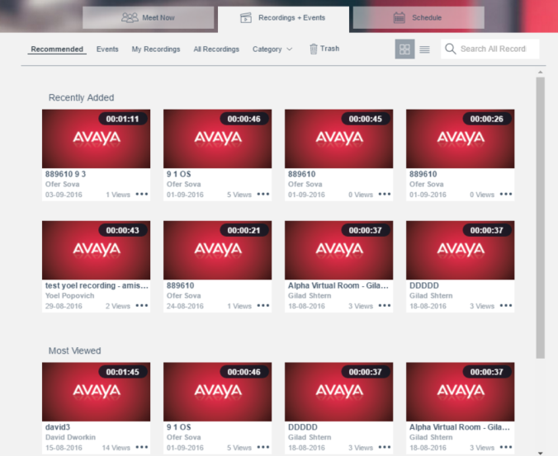
Streaming & recording made easy
Private, Enterprise “YouTube” Like Portal
Robust Streaming
  100,000 live viewers
  Event scheduling
  Private Q&A chat with moderator(s)
Universal Player
  Zero download
  Video & presentation
  iOS, Android, PC, Mac
  Compatible with Flash for older OS or browsers, Silverlight, HTML5…
Record & Playback
  From any Equinox client or Scopia system
  MP4 download for offline viewing
  1080p @ 30fps
  Gallery video layout
Mary Meeker, Morgan Stanley, Mar 2012
Notes:
The streaming and recording solution combines the interactive features of video collaboration with powerful streaming and recording capabilities. Administrators can create a private, enterprise YouTube like portal. Meetings can be recorded and saved to the system’s content library for easy, on-demand viewing or can be broadcast in real-time to any user’s PC, Mac, iOS or Android device, without specialized software for playback.
Equinox streaming delivers the highest scalability in the market with up to 100,000 simultaneous live viewers. And a flexible deployment model enables an organization can start with a compact all-in-one appliance, and expand as their capacity requirements grow.
One of the new features for Equinox streaming is that meeting participants using streaming can chat back and forth to the moderators for Q and A as an example.
And one more use case to think about – end users can easily create corporate video assets with room systems and desktops that are in effect miniature recording or broadcast studios that create standard MP4 files for editing.

Slide 35









Video enabled endpoint portFolio
Scopia XT Telepresence
H.265 Multi-stream
Scopia XT7100
HD1080p, H.265 HEVC, SVC, 10x Zoom
USB recording, iPad control standard
4/9 port MCU options
Scopia XT5000
1080p60, H.264 High Profile, SVC, 10x Zoom
USB recording, iPad control standard, 4/9 port MCU options
Scopia XT4300
1080p60, H.264 High Profile, SVC, 5x Zoom
USB recording, iPad control, 4 port MCU options
New
Scopia XT Executive 240
1080p30, H.264 High Profile, SVC
USB recording, iPad control, 4 port MCU options
H175 Video Collaboration Station
Huddle / personal system w/HDMI I/O
1080p30 wide angle detachable camera, H.264 High Profile, SVC
E159/E169 Media Stations
Docks for mobile devices
Equinox Soft Clients
1080p30
35
Notes:
H175: $1,570
Scopia XT4300: $4,500 (PTZ camera) / $2,900 (no PTZ camera)
Scopia XT7100: $13,000

Slide 36
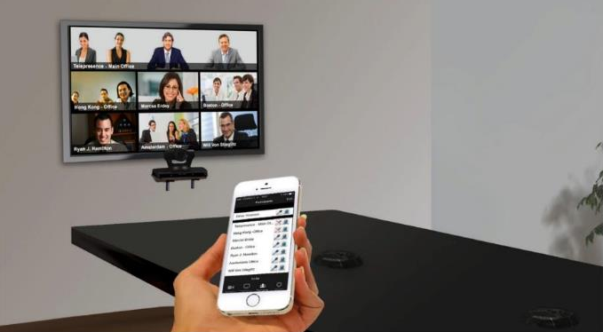
Meeting continuity – Mobile to room system
Avaya Mobile Link
Mary Meeker, Morgan Stanley, Mar 2012
Mary Meeker, Morgan Stanley, Mar 2012
Notes:
Here’s another all-too-common video conferencing scenario:
It’s your first meeting of the day, so you dial in on your smartphone while driving to the office. When you arrive at the conference room, you have to get off the call on your smartphone, search for the dial-in information and manually connect to the same meeting using the room system.
With Avaya Mobile Link, your mobile device automatically pairs and seamlessly hands off the meeting to the Scopia room system, allowing you to enjoy the room system’s crystal-clear audio, HD camera and large display.
To recap, Avaya Screen Link enables users to directly share content wirelessly from their laptops, eliminating the need to search for and connect cables between their laptop and Scopia room system.
And with Avaya Mobile Link, Desktop or Mobile users can start a meeting on their laptop or mobile device and smoothly transition that conference to a Scopia room system.

Slide 37

present wirelessly via Scopia
Avaya Screen Link
Mary Meeker, Morgan Stanley, Mar 2012
Mary Meeker, Morgan Stanley, Mar 2012
Notes:
We’ve all been there: It’s your turn to present your slides in the conference room. You first have to find the wires to connect your laptop to the video conferencing system–often, you need to pull it out of your colleague’s laptop who just presented–test that it projects on the display and to the other participants, and hope for the best.
Avaya Scopia users now have the ability to wirelessly present from their laptop–either PC or Mac–with Avaya Screen Link.
Just enter a conference room that has a Scopia room system and your laptop will automatically pair with the system using sonic recognition technology.
Anyone can present in a video meeting directly from their laptop without the need to find and plug in clumsy wires, configure their PC’s video output resolution, and fumble with the proper video out key sequence on their PC. Simply walk into a Scopia-enabled video meeting room, and your presentation can be transmitted wirelessly from your desktop to the Scopia room system.
Oh, and this capability exists whether you are in a video conference or not. Think of the value of being able to use high-resolution displays to show content in a conference room–to either the people sitting in the room with you or to everyone on a video call. Simple. And pretty cool.

Slide 38






SCOPIA XT ENDPOINT EQUINOX enhancements
Native Web Collaboration Content Support
Improved quality and experience
Less bandwidth required
Notes:
With Equinox, web collaboration between desktop clients and Scopia room systems is now sent as JPEG or PNG images instead of H.239 / BFCP video streams. This significantly enhances the quality of content sent and received and uses less bandwidth. Of course, participants using devices or endpoints not supporting this enhanced capability can still view and share content using H.239 for H.323 and BFCP for SIP.

Slide 39

Scopia XT endpoint Equinox enhancements
Scopia Control Mobile App Improvements
Automatic detection of Scopia XT system using sonic proximity
New look and feel with display rotation support
Support for iPads and iPhones (iPhone 5 or higher)
Notes:
There are a number of enhancements with the Scopia Control iOS app for controlling Scopia room systems.
If you walk into a conference room with the control app open, the Scopia room system will now detect the mobile app and automatically pair itself with the room system through sonic detection. There is also a new look and feel with support for rotating the device. And perhaps the most frequently requested enhancement for Scopia Control is that it now supports iPhones in addition to iPads.

Slide 40


SCOPIA XT ENDPOINT EQUINOX enhancements
Auto-provisioning
Easy setup
  Enter your provisioning code and get full setup
  Wherever is your endpoint
  Just two clicks to configure
Notes:
We're enhancing our room system product line for much easier deployment in both cloud and enterprise applications. Equinox Management will generate a provisioning code, and this code is simply entered at the Scopia room system to get fully setup.
For cloud partners and service providers this means easy bundling of our endpoints with services; while enterprise customers will enjoy much simpler installation and administration.
No expert or technical resource will be needed to install or provision a room system. As long as someone can hook up the cables, connect the components together, and turn on the power, they can get a room system operational without an onsite technical resource. This means room systems can be deployed by general facilities personnel.

Slide 41





Scopia XT endpoint Equinox enhancements
Presence with Avaya Aura and Avaya IP Office
Notes:
Scopia room systems can also now publish their presence status with both Aura and IP Office, and you can view the presence status of other contacts – room systems, users, or other devices registered to the presence server. The room system presence changes automatically depending on its status such as: offline, available, on a call, and do not disturb.

Slide 42

Scopia XT endpoint Equinox enhancements
Improved Security
Protocol selection by GLAN
Hide call history
AES256 for media
TLS 1.2 for SIP
DH2048 for key exchange
Certificate validation (expiration, mandatory fields,…)
Whitelist
Mary Meeker, Morgan Stanley, Mar 2012
Notes:
There are over 20 security enhancements for room systems in the new release and we only have time to cover a few of them.
Now you can disable H.323 and SIP incoming calls on either or both network interfaces. This is useful if you want to disable incoming calls on a public network, while allowing calls coming from your company network. You can hide recent calls. AES 256 is also available, along with support for TLS1.2. You can now set a minimum key size of 2,048 bits for Diffie-Hellman encryption. You can configure the policy for certificate validation.
And you can create your own white list by marking your trusted contacts. The room system will then automatically reject all incoming calls except the ones coming from your trusted favorites contacts.

Slide 43









Scopia XT endpoint Equinox enhancements
New Embedded MCU Features
Built-in MCU with H.265 support on XT7100 (unique!)
Lecturer mode in built-in MCU when XT is host
on all Scopia XT Series
Notes:
The Scopia XT7000 room system can now host H.265 multi-party meetings when supported by the remote endpoints in both SIP and H.323. This unique feature of the XT7000 embedded MCU greatly reduces the bandwidth required to host the meeting, and delivers an exceptional experience for participants.
The embedded MCU across the Scopia XT line also now supports lecturer mode, where the presenter sees continuous presence or Hollywood squares of the other participants; while the remote participants see only a large image of the presenter to avoid distractions.

Slide 44
Avaya key benefits
1
Mobile First – Enterprise Class Communications
2
Best In-App Experience Advantage
3
SMART Digital Solution Accelerator
4
Powerful Collaboration for ALL
Collaborate in Context, from Anywhere, without Compromise
Notes:
Now lets change it up and talk about Equinox in terms of it advantages.
First up is “The Mobile First – Enterprise Class Advantage”
We spent a lot of time on the UI, which is where the mobile first design paradigm comes from. We threw everything up in the air and said how do we make people super productive on a mobile device with a restrictive form factor. We started with mobile making it highly intuitive and then we expanded that out to a tablet, then to the desktop, then to a browser and that’s how the design came about. When you have more real estate, when you have different environments, or additional platform capabilities like multiple monitors, then we take advantage of that, while maintaining mobile simplicity. We looked at making the installation process as easy as possible through auto discovery – pretty much what users expect when installing an app.
For the 2016 Unified Communications Magic Quadrant, Gartner placed additional emphasis on the importance of telephony within UC because of increased expectations in the enterprise. We’ve been strong in this area since day one. Equinox delivers enterprise class, reliable, high quality voice and video with all the security and telephony features you expect – even in a mobile environment. With Multiple Device Access (MDA), users can leverage their contacts, logs and messaging transparently across devices and they have easy capabilities to record content. And perhaps one of the best features for mobile users is that VPN isn’t required for remote access.
Next, we’ve got – “The Best In-App Experience Advantage”
We all know that end users within business units are accessing their business applications in a browser. With the work done by Google with Google Apps and the increase in focus by Microsoft Office on browser-based access to productivity tools, users are now able to work completely in the browser from anywhere with this cloud application delivery model. Many of our customers have started their journey towards this approach, and with Equinox we can embed communications within the application that is being used. UC is no longer another app that sits on the desktop, the communications functions are brought forward and made available to the user in context, when they need them and how they need them, without switching applications.
And on to our 3rd Advantage – “The Smart Digital Solution Accelerator Advantage”
With the Avaya Breeze Client SDK, it’s now much easier to create and customize the experience and embed communications into existing applications and web services interfaces. The application possibilities for the SDK are almost unlimited. Users can collaborate within the context of the business processes they deal with every day. And its more than an SDK, customers can leverage the Avaya Breeze Snapp Store and save time with workflow automation and other pre-built code modules from the eco-system to extend and integrate their solutions. One last thing on the SDK, we use it ourselves to create our own clients – like Equinox that we’ve been covering today, and Oceana Workspaces.
Now our 4th advantage – Powerful Collaboration for all – this is about the conferencing and collaboration capabilities that we're going to talk about in the rest of this presentation.

Slide 45

Avaya Equinox Customer Benefits
Many Benefits of One Platform
For the Users
  One login
  One experience
  One system to learn
For the IT Administrator
  Smaller footprint
  More efficient
  Single provisioning
  One system to support & administrate
  One set of usage statistics
Mary Meeker, Morgan Stanley, Mar 2012
Notes:
As you would expect, there are many benefits of one conferencing platform with all these capabilities. It works together in a much smaller footprint. Since it’s a software solution you don't need a dedicated appliance taking up rack space for each function. Less boxes or appliances mean it's considerably more efficient. Users have one login and one easy solution to learn, and IT has one solution to support with one set of statistics, single provisioning, and a smaller footprint with higher efficiency and lower costs.

Slide 46
Avaya global services for avaya equinox™

Slide 47





Avaya Global Services
A Continuum to Increase Business Value
OPTIMIZE
Continuous Performance Analysis & Optimization
Performance Monitoring
Transformational Services Delivery
Hybrid & Mixed Environments
OPERATE
PLAN &
DESIGN
DEPLOY &
INTEGRATE
SUPPORT
Proactive Monitoring & Management Services
Cloud Hosted & Delivery Options
Direct & Partner Enabled Solutions
24x7 Remote Technical Support with Software Upgrades, State of the Art Diagnostics
Options for Onsite Support & Advanced Services
Requirements & Functional Definition
Readiness & Capacity Planning
Technical Design
Implementation
& Testing
Project & Program Management
Software Applications & Multi-Vendor Integration
Professional Services / Global Support Services / Private Cloud and Managed Services
Notes:
47
Avaya Services provides our customers with exceptional services to help them build the business case and technical design for digital transformation, provide a smooth migration and protect investments after installation with support or services based on their skills and resources.
Starting on the left, we have Plan and Design Services to get the customer started on their transformation project. It starts through a paid consulting engagement and/or a pre-sales activity where we work with the customer to determine their business goals, benchmark their current operation and provide recommendations to achieve their business outcomes. For example, our Customer Engagement Transformation service helps customer’s transform to an omnichannel experience supporting an Oceana migration. The we hand off to engineers and architects to develop the design.
Once the design is established our Deployment and Integration services provide expert implementation along with Project Management.
Let’s keep moving to the right. Start talking to your customer about their needs from a Support/Maintenance perspective. Do they need lifecycle support? Do they need onsite help? Do they have the resources to optimize and resolve issues? Or do they need Avaya to take care of it for them?
Moving on, Support Advantage Preferred and Upgrade Advantage is included in the subscription model for Oceana and Analytics. Avaya’s support has the fastest response objectives, it’s the only vendor that includes proactive prevention of outages and rapid resolution with EXPERT Systems and SLA Mon. Other vendors can’t do it with state of the art technology or they charge for it.
If the customer needs additional management support they should consider our Managed Assist and Managed Operate Services.
Often business needs change and require the solution to be optimized. Contact Center Optimization provides you an opportunity to continually demonstrate value to your customer.
Avaya services is a continuum and a way for you to stay engaged with your customer throughout their technology lifecycle. Have this discussion with your customers and don’t leave it as an afterthought.

Slide 48

Support Advantage Preferred
Award Winning Support with Automated Diagnostics and Resolution
Available
through Avaya
or an Avaya
Authorized Partner
SERVICE INCLUDES:
24 X 7 Remote technical support for software and hardware
Access to Avaya Support Website (ASW), upgrades, updates, fixes and security advisories
Enable Avaya remote support via Secure Access Link (SAL) Gateway software - Healthy SAL connectivity enables issues to be resolved 42% faster
Diagnose interoperability issues across mixed environments and isolate the root cause faster
with Multi-Vendor Collaborative Support
93% alarm auto-resolution and 73% more likely to avoid an outage with
world class automated diagnostics and proactive restoration capabilities using EXPERT SystemsSM
Unprecedented network visibility with Avaya Diagnostic Server with SLA MonTM technology to help optimize network performance and can help Avaya Tier III resolve issues up to 50% faster
Rapid resolution with response SLO of 15 minute via the web and proactive alert of network issues (PSTN & IP)
Simple & automated movement of licenses globally with Global License Portability
Increased security & ease of managing authentication policies with Avaya Secure Access Link (SAL) Policy Server software
Notes:
Avaya Support Advantage Preferred. It is a comprehensive, customizable, globally consistent support offer that you can purchase directly from Avaya or through an Authorized Partner.
24 X 7 Remote technical support for software and hardware
Access to Avaya Support Website (ASW), upgrades (via UA), updates, fixes and security advisories
Enable Avaya remote support via Secure Access Link (SAL) Gateway software - Healthy SAL connectivity enables issues to be resolved 42% faster
Diagnose interoperability issues across mixed environments and isolate the root cause faster with Multi-Vendor Collaborative Support
93% alarm auto-resolution and 73% more likely to avoid an outage with
world class automated diagnostics and proactive restoration capabilities using EXPERT SystemsSM
Unprecedented network visibility with Avaya Diagnostic Server with SLA MonTM technology to help optimize network performance and can help Avaya Tier III resolve issues up to 50% faster
Rapid resolution with response SLO of 15 minute via the web and proactive alert of network issues (PSTN & IP)
Simple & automated movement of licenses globally with Global License Portability
Increased security & ease of managing authentication policies with Avaya Secure Access Link (SAL) Policy Server software

Slide 49


Avaya Managed Services
Enables businesses to maximize investments and maintain control of operations
while freeing IT staff to shift focus to more strategic activities
MAXIMIZE YOUR INVESTMENT
EXTEND IT STAFF
Maximize performance of applications, reduce risk and improve overall quality
of service
Reduce Total Cost of Ownership through scalability
Reduce costs and management expenses, enabling a more predictable budget
Provide additional support to increase customer satisfaction by meeting Service Level Agreements
Leverage Avaya-certified staff for day-
to-day operations
Redirect high value resources to critical functions
Notes:
Unified Communications Managed Services provides customers with a comprehensive set of globally aligned services and support for managing their communications infrastructure. Managed Services for Unified Communications provides complete communications needs for enterprise customers. Services for Unified Communications are available in a variety of flexible options based upon your customer’s needs. There is a Managed Assist Offer package that includes six key ITIL (IT Infrastructure Library) components and three optional add-ons. For customers who require a more comprehensive set of management assistance they can move up the stack to our Managed Operate Offer which includes everything in the Managed Assist base package plus Release Management and Change Management. The Operate Offer has three optional add-ons which customers can choose from. Each package provides measurable cost savings, simplifies the delivery and management of communications, and allows customers to focus on core business activities while Avaya and its partners deliver the critical services.

